Slide 1
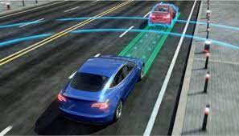

Automatic Vehicle Horn and Alert System
Smart vehicle Horn System

Slide 2
IoT Based Project
NAME | REGISTRATION | ROLL
Anurag Kumar | 12213393 | 71
Abhishek Singh | 12213378 | 70
Dheeraj kumar | 12208863 | 59
Submitted to :
Dr Shankey Saxena

Slide 3
ACKNOWLEDGEMENT
We would like to express our deep appreciation to all who provide us the possibility to complete this project . A special gratitude we give to our project mentor Dr Shankey Saxena whose continuously encouragement helped us to coordinate our project specially in writing this report.
Many Thanks goes to Dr Shankey Saxena who has invested his full effort to guide our project team to do this project.

Slide 4
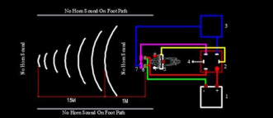
Introduction
Automatic Horn and Vehicle Detection System is an automatic system which is designed for large vehicles for automatic horn and backside vehicle detection . We are using two ultrasonic sensors one is on the front of the vehicle for detecting the objects and one ultrasonic sensor is on the backside of the vehicle to detect the vehicle from backside and we are using buzzer and LEDs for alerts ,here we are using Node MCU as microcontroller .
The system consists of two main parts .The Hardware and The Software
The Hardware system consists Node MCU , Ultrasonic sensors, Buzzer, Led
The Software consists of the Arduino IDE and Node MCU ESP8266 firmware.
It is programmed using the Arduino IDE and Node MCU firmware .The system is designed to send alert using buzzer and leads when the vehicle or object is detected on the set range.
Automatic Horn and Vehicle Detection System
Description
1. Node MCU
2.Ultrasonic sensor (2)
3.LED
4.BreadBoard
5.Resistor
6.Buzzer
7.Jumper Wires

Slide 5
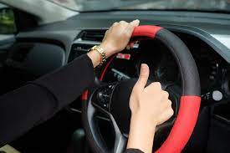
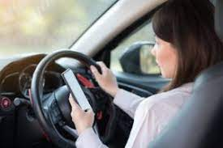
OBJECTIVE OF THE PROJECT
The main objective of our project is to contribute in reducing the road accidents which are happened due to no horn by the driver , we say that lot of times driver of the vehicle forget to blow the horn so it may be cause of accident. Basically our project is for loaded or large vehicles ,we are providing automatic horn when any object is detect at certain distance , the horn will be blown automatically, another feature of our project will be detecting the vehicles which are on the backside of the vehicle so it will alert the driver that there is a vehicle on the backside ,so you can give them a pass by . So our objective is to reduce the accidents which are happened hue to forgetting of horn blown.

Slide 6
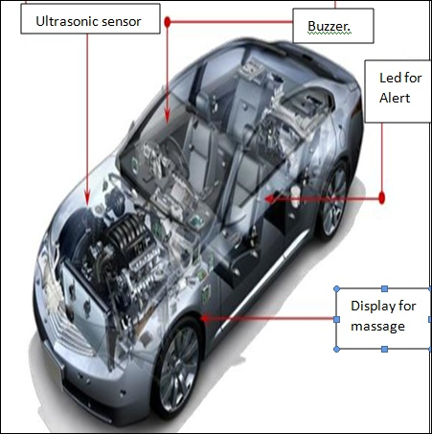
COMPONENTS DETAILS
These are the components that we are using for this IOT based project .
1. Node MCU.
2.Ultrasonic sensor (2).
3.LED(2).
4.BreadBoard.
5.Resistor.
6.Buzzer.
7.Jumper Wires.
8.Power shell.

Slide 7
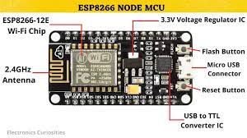
NodeMCU
It is a low cost Wi-Fi Microcontroller Board that is based on the ESP8266 chip . It has a build in module voltage regulator and can be powered either by a USB port or a external battery It has a wide range of applications in the field of Internet of things .
It has 17 digital Input output pins of which 6 can be used as PWM outputs ,1 analog pin , a 16MHz oscillator , a USB connection ,a power jack and one reset button.
Specifications
Microcontroller: Tensilica 32-bit RISC CPU Xtensa
Operating voltage:3.3V
Input voltage : 7-12V
Digital I/O Pins :16
Analog Input Pins :1
UARts:1
SPIs:1
Flash Memory:4Mb
SRAM:64kb
Clock Speed:80MHz

Slide 8
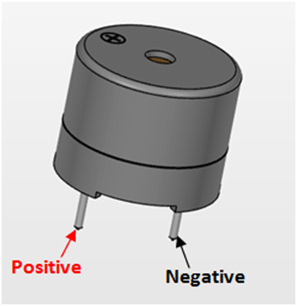
Buzzer
it is basically a sound device which converts the audio signal to sound signal. The main use of this device is to prompt or alarm . It has different designs and applications so it is used for many purposes , music sound flute sound , buzzer sound , electric bell sound can be produced .
The buzzer is also known as piezo , which is used for generating sound .Its like a digital component which is generally connected to the digital outputs and its emits the tone when its output is high. The grove Buzzer is operated at 3.3V as well as 5V with the sound of 85 decibels. This can be used to give the module of sound to our application just like button’s click sound of an digital watch.

Slide 9
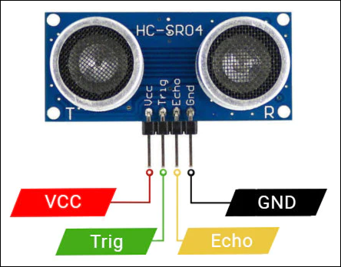
ULTRASONIC SENSOR
Ultrasonic/level sensors use ultrasonic waves to measure distance, as the name suggests . An ultrasonic wave is emitted by the sensor head, which then receives the wave reflected back from the target. Ultrasonic and level sensors use the difference in time between emission and reception to calculate the target's distance
Sensor Description
The module which we used in our project is powered by 5V supply . The trigger pin has to be made high for 10usec and after that turned off. This results that the transistor to send an ultrasonic wave with frequency of 40Hz.

Slide 10
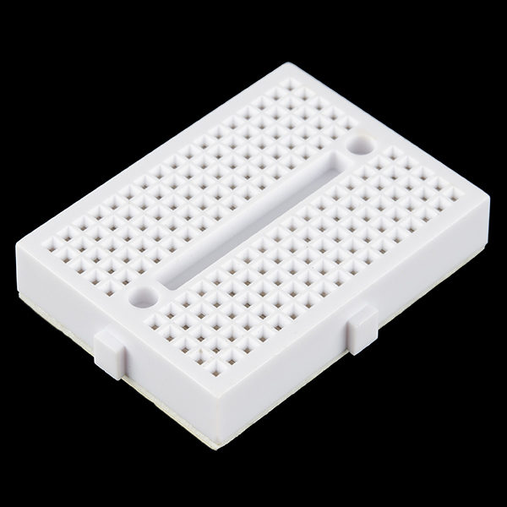
BREAD BOARD
A breadboard is a rectangular plastic board with a bunch of tiny holes in it. These holes let you easily
Insert electronic components.
to prototype (meaning to build and test an early version of) an electronic circuit, like this one with a battery, switch, resistor, and an LED (light-emitting diode).
are not permanent, so it is easy to remove a component if you make a mistake, or just start over and do a new project. This makes breadboards great for beginners who are new to electronics. You can use breadboards to make all sorts of fun electronics projects, from different types of robots or an electronic drum set, to an electronic rain detector to help conserve water in a garden, just to name a few.

Slide 11
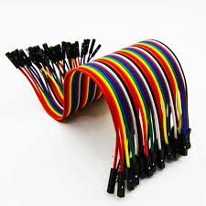
Led
jumpers are tiny metal connectors used to close or open a circuit part. They have two or more connection points, which regulate an electrical circuit board.
Their function is to configure the settings for computer peripherals, like the motherboard. Suppose your motherboard supported intrusion detection. A jumper can be set to enable or disable it.
jumper wire are electrical wires with connector pins at each end. They are used to connect two points in a circuit without soldering.
You can use jumper wires to modify a circuit or diagnose problems in a circuit. Further, they are best used to bypass a part of the circuit that does not contain a resistor and is suspected to be bad.
This includes a stretch of wire or a switch. Suppose all the fuses are good and the component is not receiving power; find the circuit switch. Then, bypass the switch with the jumper wire.

Slide 12
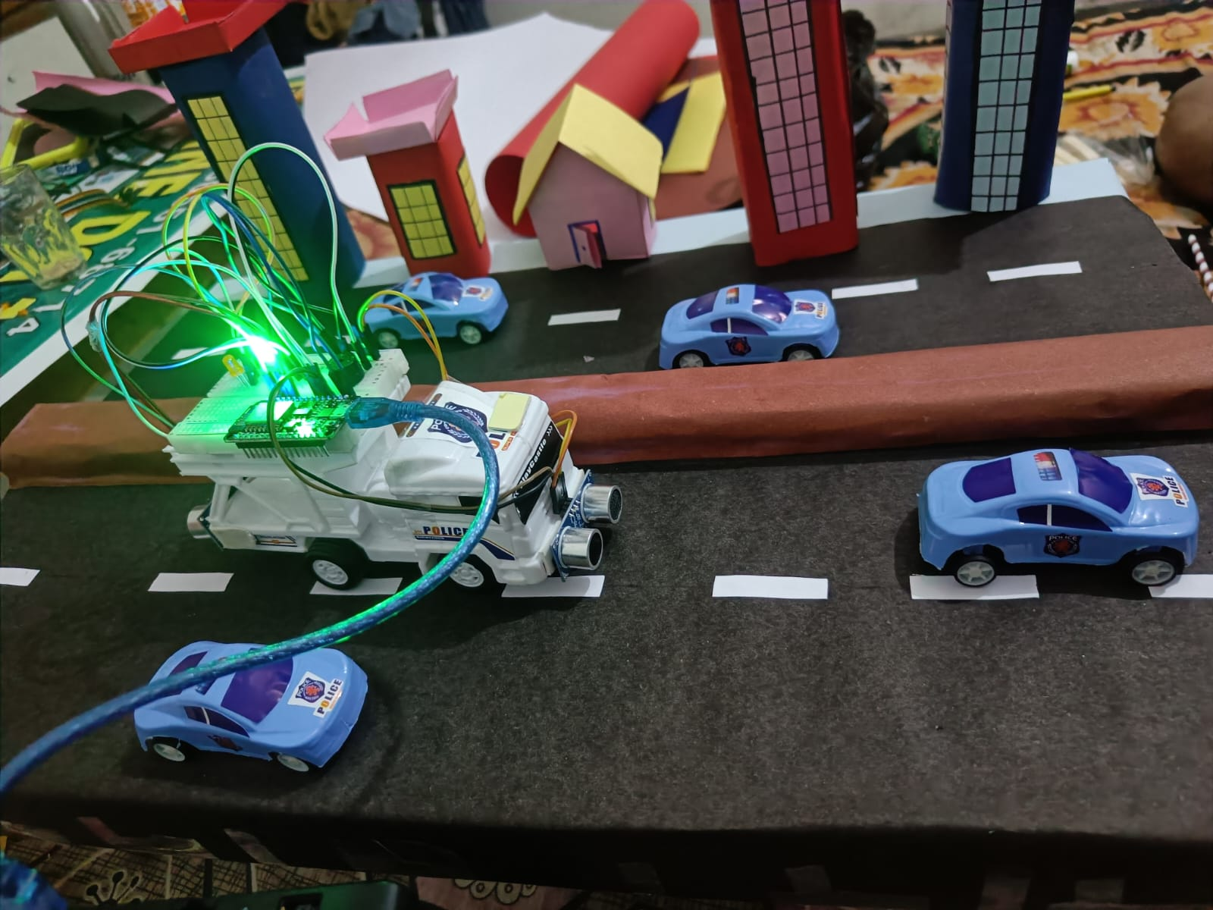
Working
In this project we are using NodeMCU ESP8266 as microcontroller and we are using Arduino IDE for uploading the program in the microcontroller and for detecting the distance of vehicle or object we are using two ultrasonic sensor one is fitted on the front of the vehicle and another one is fitted on the backside of the vehicle , we are using piezo buzzer as a horn and Led for alerting the driver that there is any object behind the vehicle , we are connecting this system through the breadboard with jumper wire .For power supply we are using 5V battery .

Slide 13
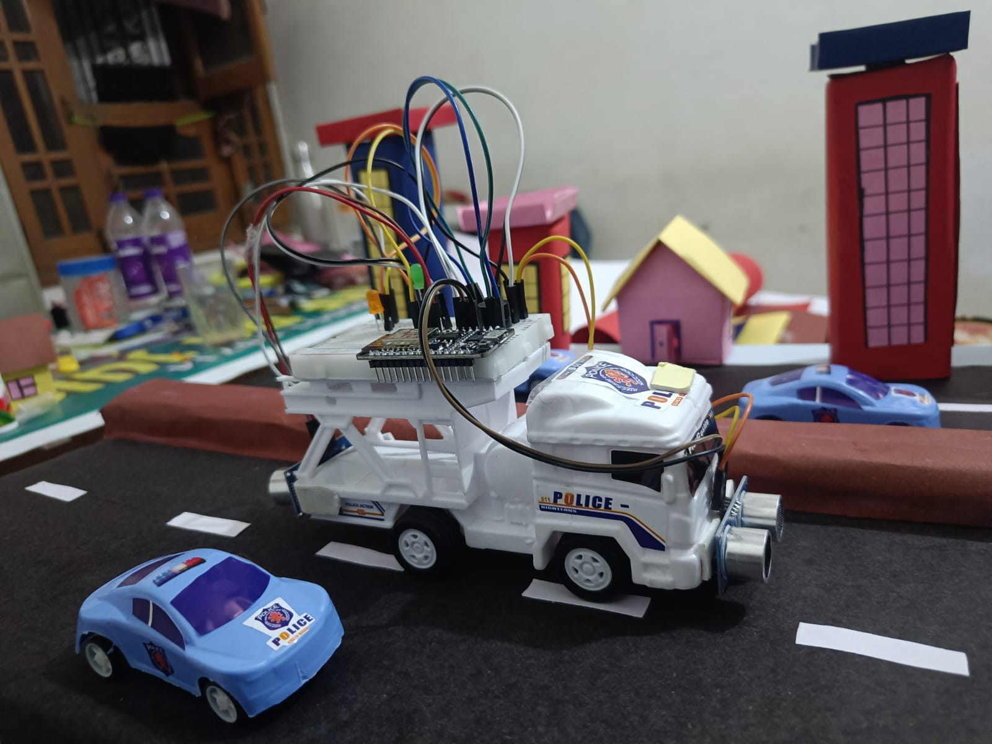
Basically what everything will work in this project we are explaining here so when the ultrasonic sensor which is on the front of the vehical detect any object at the certain distance then the buzzer will blow ,we will set the distance in the program according to our view and to show the concept and the backside sensor detecting any object at certain distance will alert the driver by blinking the Led fitted just in front of the driver .

Slide 14
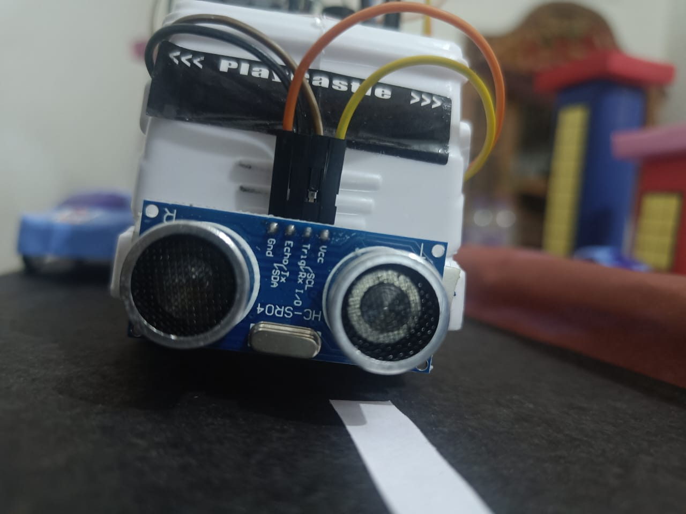
Ultrasonic sensor fitted on the front of vehicle:
Front ultrasonic sensor will detect the object or any vehicle if the distance is less than the 10 cm then horn will blow for 2 second and stop for two second if the object or vehicle is not moved away then it will blow the horn again.
NOTE: Distance will be change when it will introduce in real life it change to 10 meter

Slide 15
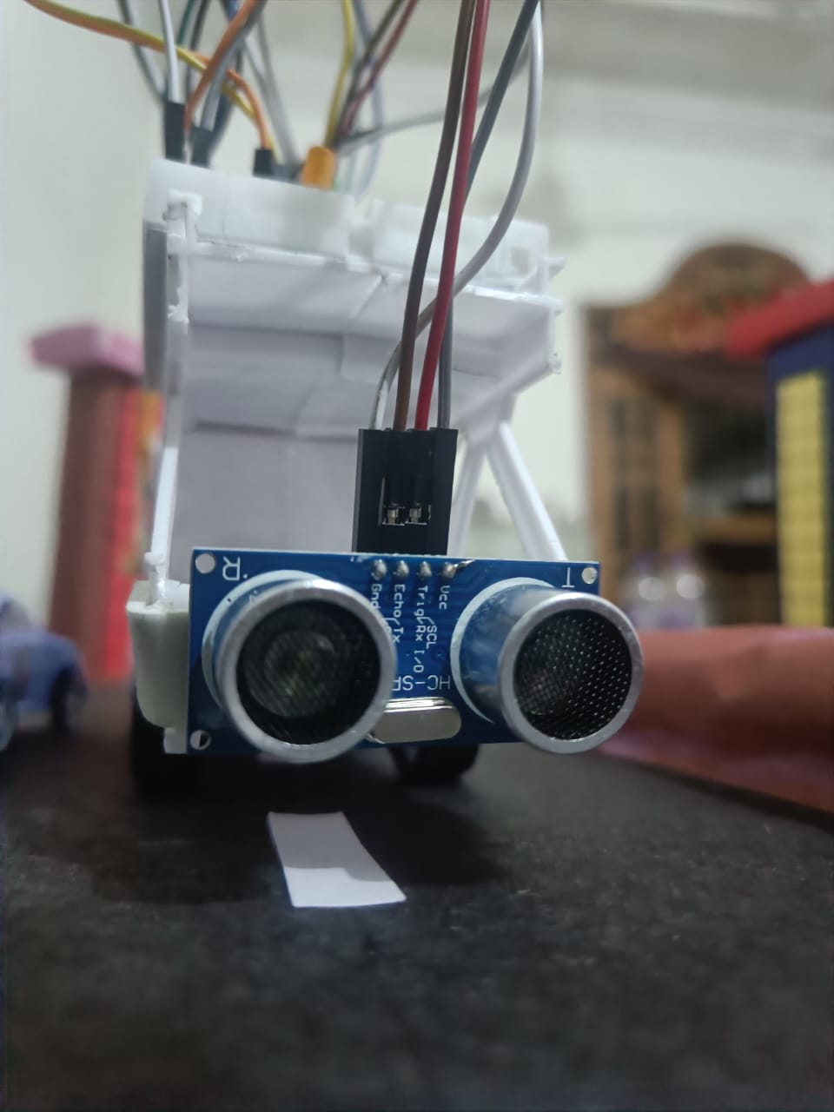
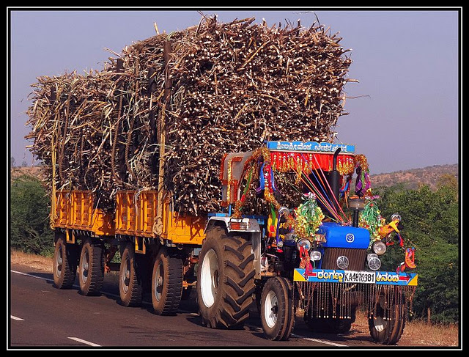
Ultrasonic sensor fitted on the backside of vehicle:
IF this sensor detect any vehicle from back side then it will alert the driver that a vehicle is coming from back side an alert the driver by blinking the LED light.
Why we need this sensor in the back side of the vehicle?
As many heavy vehicle specially like tractor driver did not able to see the vehicle behind them when it is loaded

Slide 16
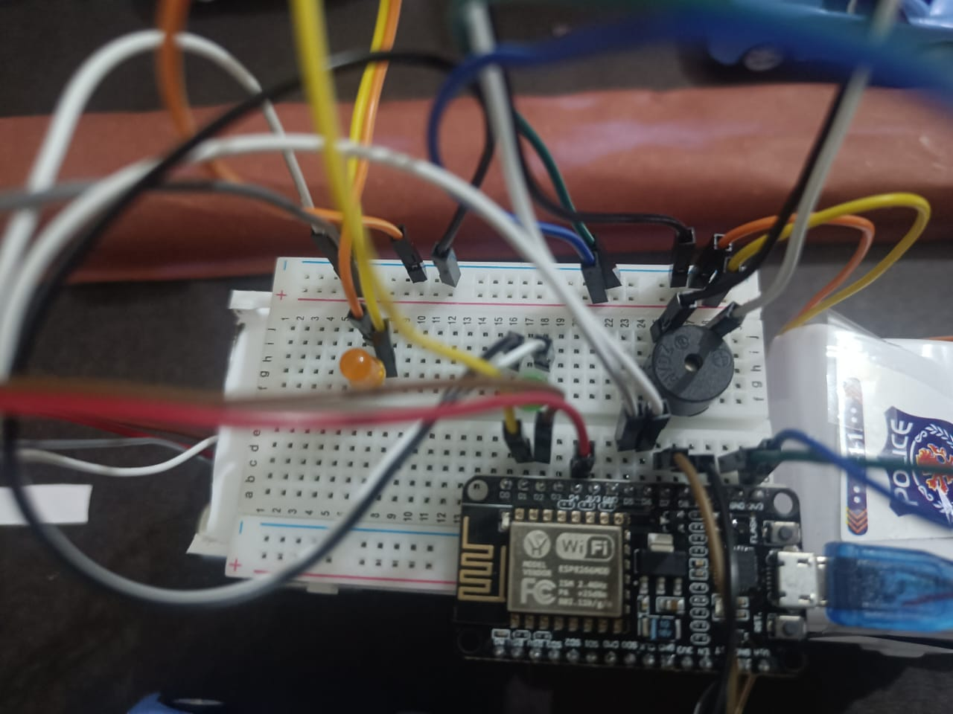
Connection of NodeMCU ESP8266 buzzer, LED

Slide 17

Driver Will Received Signal when No vehicle is in the front and backside of the vehicle:
Whenever there is no any vehicle In the front and backside of the vehicle the Green LED will glow And it inform the driver that there is no any vehicle in the range of 10 meter.
GREEN LED

Slide 18
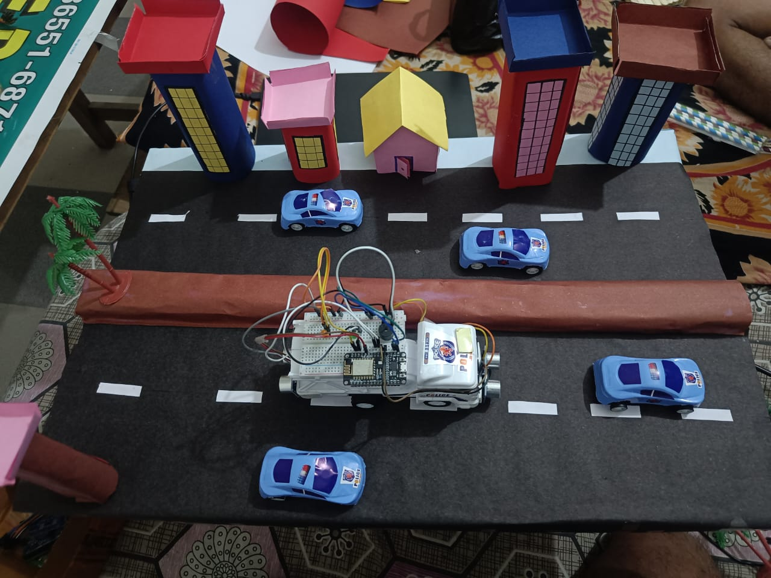
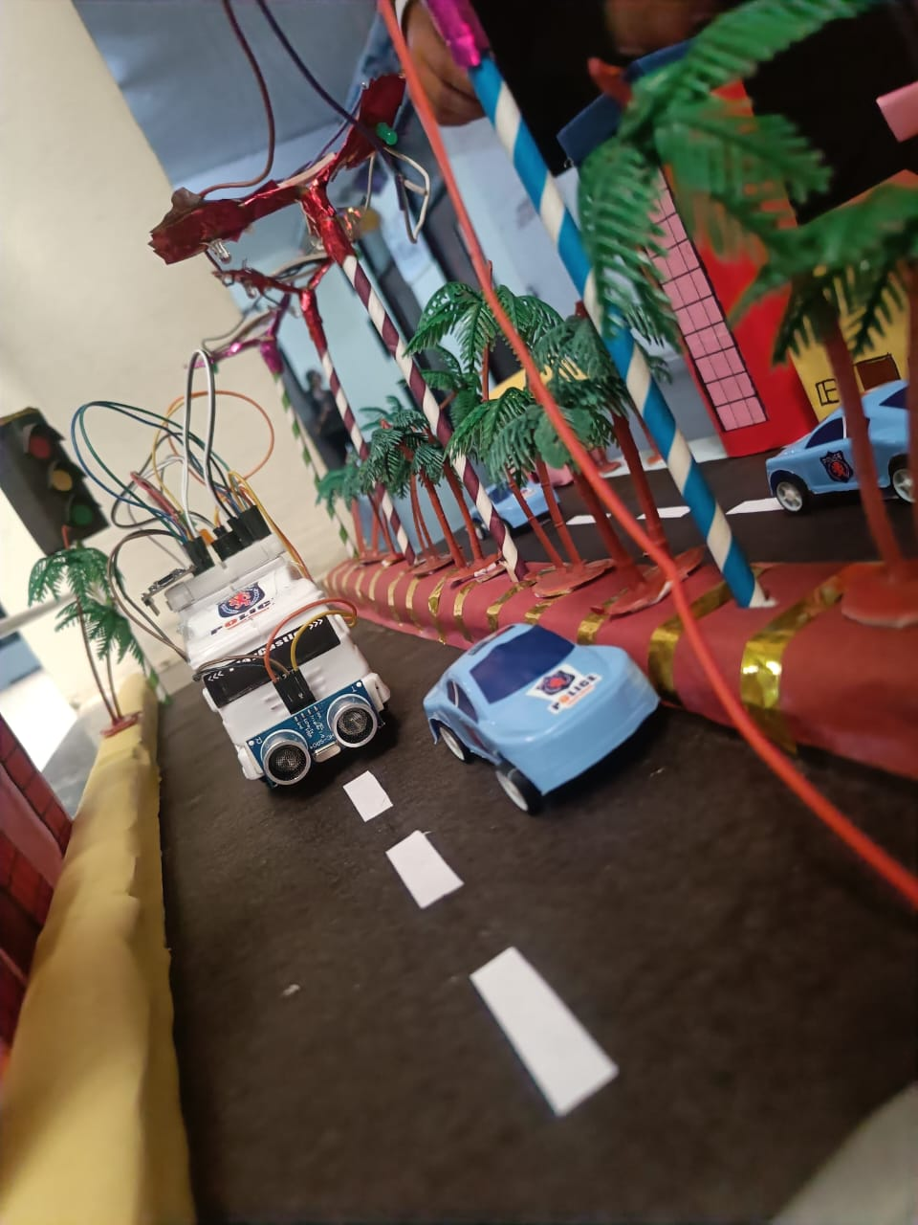
Conclusion:
Driver of the vehicle will be alert by the LED automatically.
Horn will be blow automatically when vehicle come under the range.
Some time Driver are busy in the applying break , clutch etc and not able press the horn button at that situation this will blow the horn automatically.

Slide 19


